Slide 1


Git Introduction
Nguyen Dinh Tung Lab Team
Notes:
click ảnh, chọn “Replace Image” để thay ảnh.

Slide 2


Git Introduction
2(a+b)
dev
Git Init
2π*R^2
π*R^2
mult
add
Person A
a * b
sub
Person B
merge
a * b
sub
rebase

Slide 3
Git Team Workflow
A
B
A
B
Git checkout -b B
Add commit
Git pull
Git rebase/merge A
B
B
B => A
Add more commit
Git push
Create pull request

Slide 4
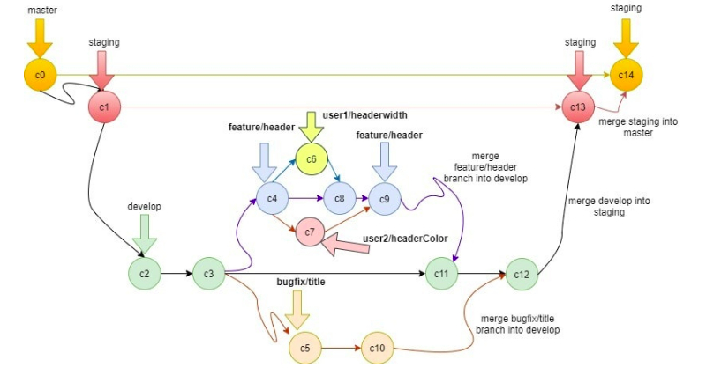
Git Branching Strategy
Branch Strategy

Slide 5
Git commit format
Type | Meaning
feat | actual feature implementation
style | code style and code clean up
test | actual test implementation
fix | bug fix
refactor | refactoring that doesn't affect the behavior of the code
chore | no production code changes, but more like configuration and setup
Examples:
feat(users) add authentication
fix(logout) clean up cookie
style(*) fix indentation

Slide 6
Git Tips
Revert staging / editing files:
git reset HEAD <file_path>
git checkout -- <file_path>
Uncommit / edit commit
git reset [hard/soft] HEAD~<N>
git commit --amend
Change git commit history
git rebase -i HEAD~<N>

Slide 7
Lenh git | Y nghia
git checkout | Switch to a new branch
git add | save
git stash save “” | Storage

